Slide 1


RECYCLED PLASTIC BRICKS

Slide 2

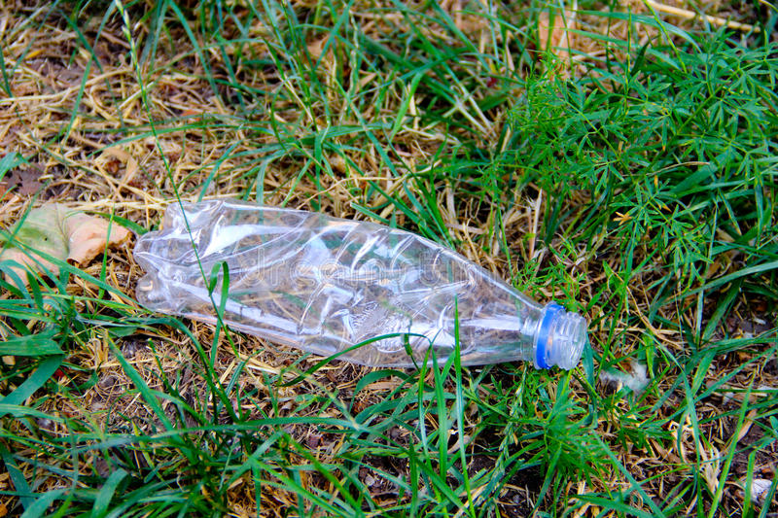
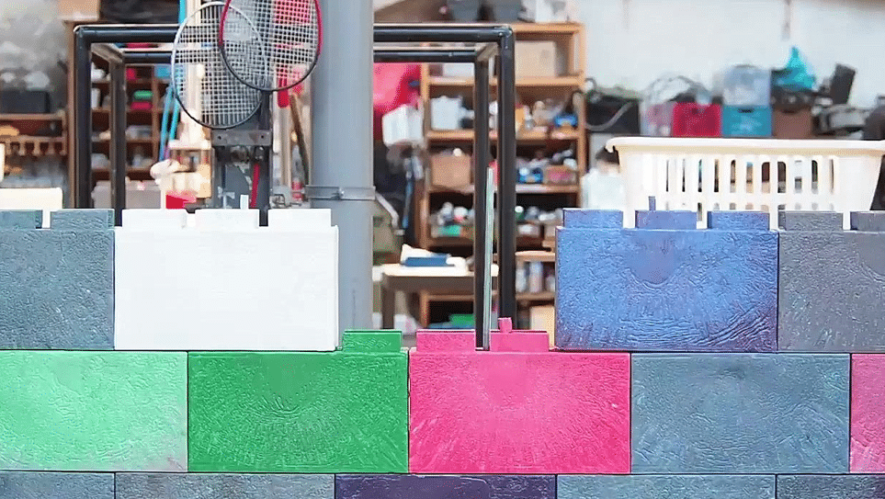
FROM TRASH
TO TROVE

Slide 3
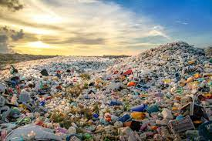
This has lead to plastic pollution which is a global issue. A truckload of trash is dumped into the ocean every minute, and it is thought that 90% of this waste originates from low-income nations. The construction sector is also responsible for 38% of global carbon emissions, given that common building materials like concrete have a high carbon footprint. This causes the devastation of the terrain in order to obtain more stone and the dredging of the ocean floor for sand. Nigeria generates over 2.5 million tones of plastic waste annually with Lagos State been the highest at 870 thousand tonnes annually, contributing about 35% of the Nations plastic waste.
It has become a necessity to source for alternative building materials due to inflation and high cost of construction. Over 1.6 billion people lack sufficient housing globally with Nigeria at 28 million.
Plastic is the fourth most used material in the world and the most used material in the food and beverage industry. Because of its chemical structure and weight, it enables mankind to use it for different purposes with over one million plastic bags produced per minute worldwide and less than 10% of it is recycled.

Slide 4
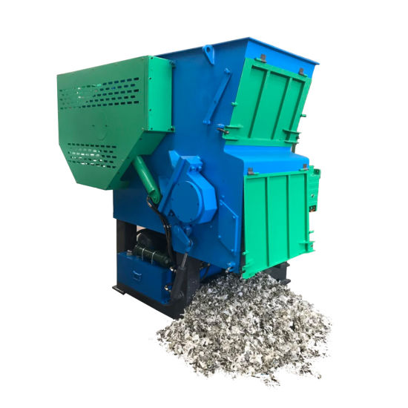
WHY PLASTIC?
Cost Effective
Waste Reduction
Good Compressive Strength
In line with the Sustainable Development Goals (SDGs) for sustainable cities and communities, Sheltered hope Initiative will be providing sustainable homes for 1000 homeless persons by recycling plastic waste into bricks.
The plastics will be sourced locally as Lagos State generates 870,000 tonnes of plastic waste annually.
The recycled plastic bricks will be made using Precious Plastic's open-source recycling machines, which cost about N 20million to purchase. The brick is stackable, overlapping the bricks underneath and has interlocking teeth.
In terms of workmanship, hollow block cost N8,000 per square meter while plastic bricks cost about N5,800 per square meter

Slide 5
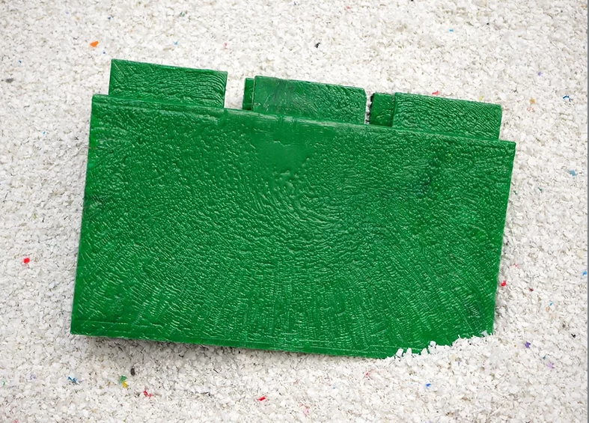
With a weight of 1.5kg per plastic brick as compared to regular sandcrete blocks of 19kg, it makes it easier to carry and install. This helps to reduce the load on the structure.
Having a compressive strength of 271N/mm², it is 6 times stronger than regular blocks with a compressive strength of 4N/mm². While hollow blocks take about 7 days before use, it takes 13 minutes for the plastic brick to be ready from shredding to setting, thus increasing productivity.
The brick can be used both alone as a load-bearing unit and in conjunction with conventional building techniques like wood and metal.
Each brick is made to fit together like Lego and can be quickly built using only a hammer. enabling even a novice builder to construct a sturdy and long-lasting building. Additionally hollow, each brick has less thermal bridging and better insulating qualities than typical masonry building.
​

Slide 6
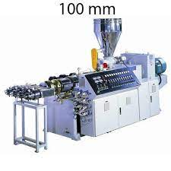
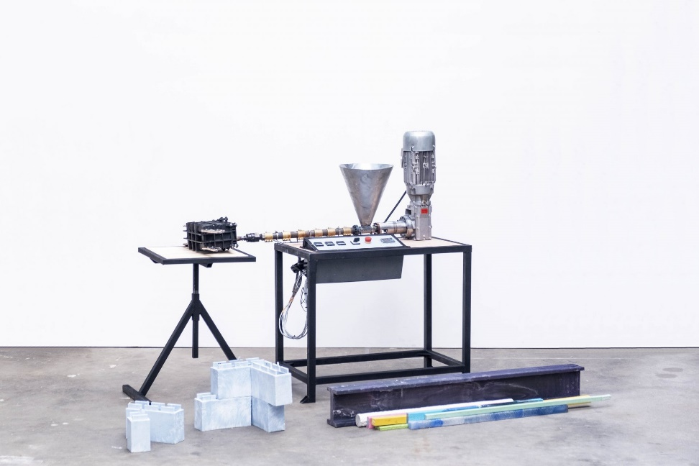
THE PROCESS
Plastic Waste
Shredding (3 minutes)
Extrusion (4 minutes)
Final Recycled Brick (7 minutes)
$2,000 each
$30,000 each (four moulds)
$6,000 each (one mould)

Slide 7
THANK YOU.

